Slide 1
Finishing up Reich (2014) discussion

Slide 2
Plant economics
Idea of costs and benefits
Cost and benefit to each trait
What might these be?
How would they differ in fast and slow species?
How would they differ with environment?

Slide 3
Plant gas exchange

Slide 4
CO₂
CO₂
O₂
H₂O

Slide 5
Photosynthesis
Respiration
CO₂
CO₂
O₂
H₂O
Transpiration

Slide 6
Photosynthesis
Respiration
CO₂
CO₂
O₂
Small groups: Why do all these physiological processes?
Make a list!
H₂O
Transpiration

Slide 7
H₂O
Transpiration

Slide 8
NASA

Slide 9
How do plants transpire?
H₂O
Transpiration

Slide 10
Water potential gradients!
Air
Lowest Ψ (“Dry”)
Leaves
Xylem
Roots
Soil
Highest Ψ (“Wet”)

Slide 11
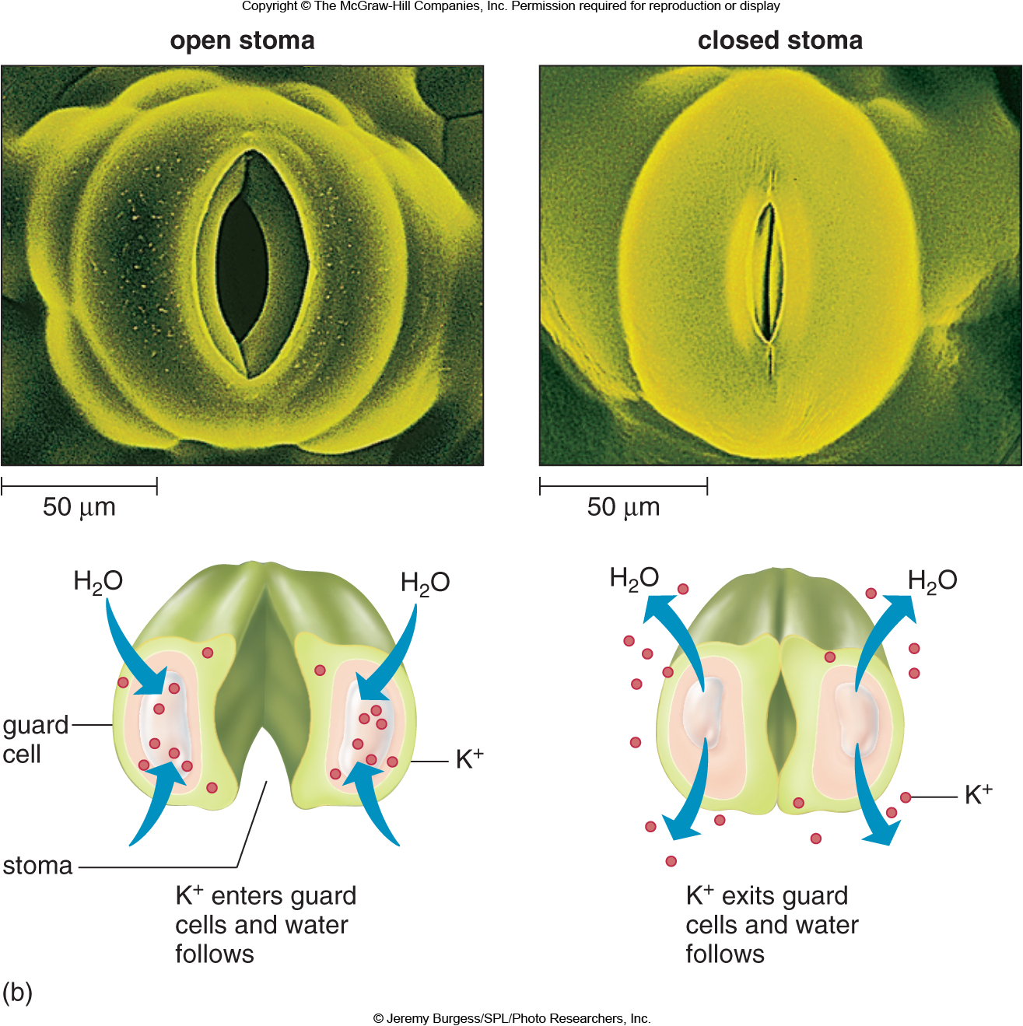
Transpiration regulation: Guard cells
Create open or closed stomata by changing turgor pressure

Slide 12
Respiration
CO₂

Slide 13
Respiration
How do plants respire?
CO₂

Slide 14
Respiration - the recipe
C₆H₁₂O₆ + 6O₂ → 6CO₂ + 6H₂O + energy

Slide 15
Respiration - the recipe
C₆H₁₂O₆ + 6O₂ → 6CO₂ + 6H₂O + energy
Glucose
(primary substrate)

Slide 16
Respiration - the recipe
Oxygen
(aids efficiency; not always necessary)
C₆H₁₂O₆ + 6O₂ → 6CO₂ + 6H₂O + energy
Glucose
(primary substrate)

Slide 17
Respiration - the recipe
Oxygen
(aids efficiency; not always necessary)
C₆H₁₂O₆ + 6O₂ → 6CO₂ + 6H₂O + energy
Glucose
(primary substrate)
Carbon dioxide + water
(lost)

Slide 18
Respiration - the recipe
Oxygen
(aids efficiency; not always necessary)
Energy!
(primary end product)
C₆H₁₂O₆ + 6O₂ → 6CO₂ + 6H₂O + energy
Glucose
(primary substrate)
Carbon dioxide + water
(lost)

Slide 19
Respiration – Main processes
Glycolysis
Citric Acid Cycle
Electron Transport System

Slide 20
Respiration – Main processes
Glycolysis
Citric Acid Cycle
Electron Transport System

Slide 21
Respiration – Main processes
Glycolysis
function: make some ATP & substrate for making [x]H
Citric Acid Cycle
Electron Transport System

Slide 22
Respiration - Glycolysis
Step 1: “Investment”

Slide 23
Respiration - Glycolysis
Step 1: “Investment”
Use 2 ATP to create 2 phosphorylated 3-C sugars from glucose
Glucose (6 C)

Slide 24
Respiration - Glycolysis
Step 1: “Investment”
Use 2 ATP to create 2 phosphorylated 3-C sugars from glucose
Glucose (6 C)
ATP -> ADP (x 2)
3C + 1 P
3C + 1 P

Slide 25
Respiration - Glycolysis
Step 2: “Reward”

Slide 26
Respiration - Glycolysis
Step 2: “Reward”
Use 2 phosphorylated 3-C sugars to create 4 ATP and Pyruvic acid
3C + 1 P
3C + 1 P

Slide 27
Respiration - Glycolysis
Step 2: “Reward”
Use 2 phosphorylated 3-C sugars to create 4 ATP and Pyruvic acid
3C + 1 P
3C + 1 P
+P (NAD+ -> NADH)
+P (NAD+ -> NADH)
3C + 2 P
3C + 2 P

Slide 28
Respiration - Glycolysis
Step 2: “Reward”
Use 2 phosphorylated 3-C sugars to create 4 ATP and Pyruvic acid
3C + 1 P
3C + 1 P
+P (NAD+ -> NADH)
+P (NAD+ -> NADH)
3C + 2 P
3C + 2 P
ADP -> ATP
ADP -> ATP
3C + 1 P
3C + 1 P

Slide 29
Respiration - Glycolysis
Step 2: “Reward”
Use 2 phosphorylated 3-C sugars to create 4 ATP and Pyruvic acid
3C + 1 P
3C + 1 P
+P (NAD+ -> NADH)
+P (NAD+ -> NADH)
3C + 2 P
3C + 2 P
ADP -> ATP
ADP -> ATP
3C + 1 P
3C + 1 P
ADP -> ATP
ADP -> ATP
Pyruvic acid
Pyruvic acid

Slide 30
Respiration - Glycolysis
Ingredients
Glucose
ATP (2)
Outcomes
Pyruvic acid
ATP (4)
NADH (2)

Slide 31
Respiration – Main processes
Glycolysis
Citric Acid Cycle
Electron Transport System

Slide 32
Respiration – Main processes
Glycolysis
Citric Acid Cycle
function: make [x]H
Electron Transport System

Slide 33
Respiration – Citric Acid Cycle

Slide 34
Respiration – Citric Acid Cycle
Step 1: Production of Acetyl CoA from pyruvic acid (“Transformation”)
Produces CO₂ and NADH
Pyruvic acid (3-C)
CO₂
NAD -> NADH
Acetyl CoA (2-C)

Slide 35
Respiration – Citric Acid Cycle
Step 2: Production of “energy packets” (NADH, FADH₂)
Acetyl CoA (2-C)
CO₂
4-C acid
6-C acid
5-C acid
NAD -> NADH
CO₂
NAD -> NADH
ADP -> ATP
NAD -> NADH
4-C acid
4-C acid
FAD -> FADH₂

Slide 36
Respiration – Citric Acid Cycle
Ingredients
Pyruvic acid
Outcomes
NADH
FADH₂
ATP
CO₂

Slide 37
Respiration – Main processes
Glycolysis
Citric Acid Cycle
Electron Transport System

Slide 38
Respiration – Main processes
Glycolysis
Citric Acid Cycle
Electron Transport System
function: make ATP

Slide 39
“Cashing out” - Electron transport system

Slide 40
Respiration – Electron transport system
Take reduced “energy packets” (NADH, FADH₂) and convert ADP to ATP
”Cashing in” electrons for ATP
Driven by a series of protein complexes along the mitochondrial membrane
NADH + ADP + P + O₂ -> NAD + H₂O + ATP
FADH₂ + ADP + P + O₂ -> FAD + H₂O + ATP

Slide 41
Respiration - accounting

Slide 42
Respiration - accounting
1 Glucose => 36 ATP (net)

Slide 43
Respiration - accounting
1 Glucose => 36 ATP (net)
1760 kcal / 1 Glucose

Slide 44
Respiration - accounting
1 Glucose => 36 ATP (net)
1760 kcal / 1 Glucose
19 kcal / 1 ATP

Slide 45
Respiration - accounting
1 Glucose => 36 ATP (net)
1760 kcal / 1 Glucose
19 kcal / 1 ATP
(19 * 36) / 1760 = 39% total efficiency

Slide 46
Photosynthesis
CO₂
O₂

Slide 47
Photosynthesis
CO₂
O₂
How do plants photosynthesize?

Slide 48
Photosynthesis – the recipe
Chlorphyll
6CO₂ + 12H₂O + light → C₆H₁₂O₆ + 6O₂ + 6H₂O
Enzymes

Slide 49
Photosynthesis – the recipe
Chlorphyll
6CO₂ + 12H₂O + light → C₆H₁₂O₆ + 6O₂ + 6H₂O
Enzymes

Slide 50
Photosynthesis – CO₂

Slide 51
Photosynthesis – CO₂
CO₂ diffuses into plant leaves through stomata
Ultimately reaches the chloroplasts
Function: provides C

Slide 52
Photosynthesis – CO₂
1 acre corn plot takes up > 5000 lbs of CO₂ a year

Slide 53
Photosynthesis – the recipe
Chlorophyll
6CO₂ + 12H₂O + light → C₆H₁₂O₆ + 6O₂ + 6H₂O
Enzymes

Slide 54
Photosynthesis - Water
Solution for CO₂ to dissolve
Source of the electrons involved
6CO₂ + 12H₂O + light → C₆H₁₂O₆ + 6O₂ + 6H₂O

Slide 55
Photosynthesis – the recipe
Chlorophyll
6CO₂ + 12H₂O + light → C₆H₁₂O₆ + 6O₂ + 6H₂O
Enzymes

Slide 56
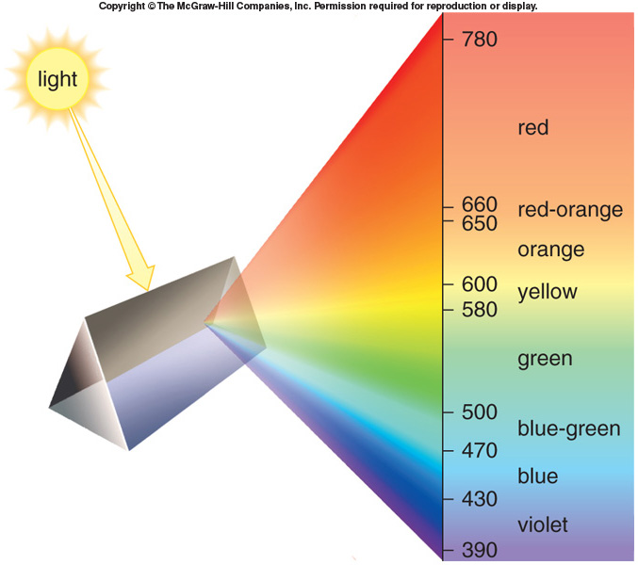
Photosynthesis - Light
Provides the energy for photosynthesis
Absorbed in the red and blue portion of the spectrum

Slide 57
Photosynthesis – the recipe
Chlorophyll
6CO₂ + 12H₂O + light → C₆H₁₂O₆ + 6O₂ + 6H₂O
Enzymes

Slide 58
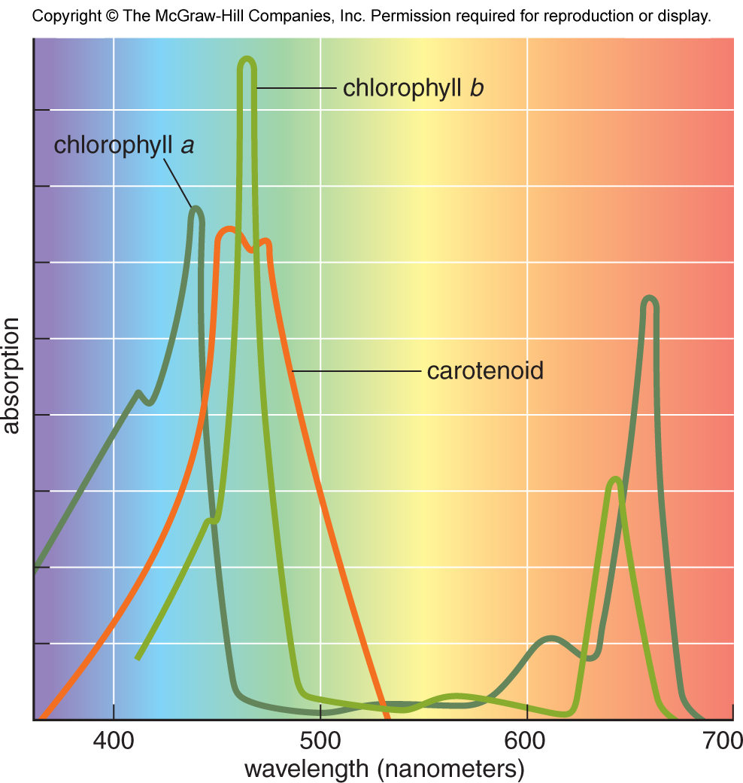
Photosynthesis - Chlorophyll
Molecules that absorb light
Come in different flavors
Absorb in different portions of the spectrum

Slide 59
Photosynthesis – the recipe
Chlorphyll
6CO₂ + 12H₂O + light → C₆H₁₂O₆ + 6O₂ + 6H₂O
Enzymes

Slide 60
Photosynthesis - enzymes
Function: to catalyze the reactions
Very temperature sensitive
Example --> Rubisco
Rubisco activity
Galmes et al. (2016)

Slide 61
Photosynthesis – the recipe
Chlorphyll
6CO₂ + 12H₂O + light → C₆H₁₂O₆ + 6O₂ + 6H₂O
Enzymes

Slide 62
Photosynthesis - glucose
Not actually the first product!
Functions:
Produce energy during respiration
Lipid and starch formation
Plant structure formation

Slide 63
Photosynthesis – the recipe
Chlorphyll
6CO₂ + 12H₂O + light → C₆H₁₂O₆ + 6O₂ + 6H₂O
Enzymes

Slide 64
Photosynthesis – Oxygen and Water
By products
May be recycled or emitted as gas through leaves

Slide 65
Two phases of photosynthesis
Light-dependent reactions
Light-independent reactions (aka Dark reactions)

Slide 66
Light-dependent reactions

Slide 67
Light-dependent reactions - Steps
Photons of light are absorbed
Electrons are excited! (boosted to higher energy level)
Water is split
Releases electrons, hydrogen ions, and oxygen gas
Electrons flow down electron transport chain
ATP and NADPH are produced (stored energy)

Slide 68
Light-dependent reactions - Steps
Photons of light are absorbed
Electrons are excited! (boosted to higher energy level)
Water is split
Releases electrons, hydrogen ions, and oxygen gas
Electrons flow down electron transport chain
ATP and NADPH are produced (stored energy)

Slide 69
Light-dependent reactions - Steps
Photons of light are absorbed
Electrons are excited! (boosted to higher energy level)
Water is split
Releases electrons, hydrogen ions, and oxygen gas
Electrons flow down electron transport chain
ATP and NADPH are produced (stored energy)

Slide 70
Light-dependent reactions - Steps
Photons of light are absorbed
Electrons are excited! (boosted to higher energy level)
Water is split
Releases electrons, hydrogen ions, and oxygen gas
Electrons flow down electron transport chain
ATP and NADPH are produced (stored energy)

Slide 71
Light-dependent reactions - Steps
Photons of light are absorbed
Electrons are excited! (boosted to higher energy level)
Water is split
Releases electrons, hydrogen ions, and oxygen gas
Electrons flow down electron transport chain
ATP and NADPH are produced (stored energy)

Slide 72
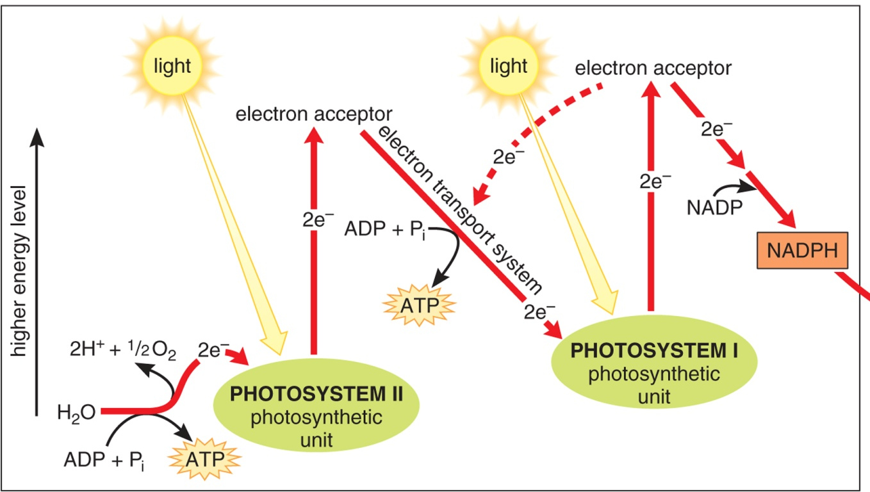
Light-dependent reactions
Ingredients
Light
H2O
NADP+
ADP
P
Outcomes
ATP
NADPH
O2
H+

Slide 73
Light-independent reactions (“dark reactions”)

Slide 74
Light-independent reactions - Steps
Take ATP and NADPH from light-dependent reactions
Convert CO₂ into sugars
Restart the cycle

Slide 75
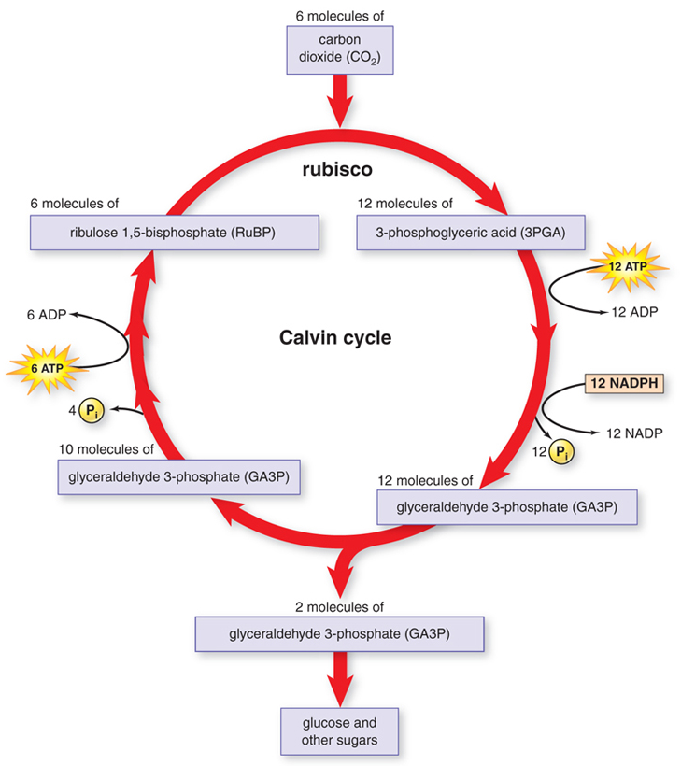

Slide 76
1. Rubisco grabs CO₂
(1 carbon)

Slide 77
2. CO₂ (1 carbon) combines with RuBP (5 carbon)

Slide 78
2. GA3P (3 carbon) is produced

Slide 79
3. Some GA3P (3 carbon) are used for sugars, others restart the chain

Slide 80
(1C)
(5C)
(3C)
(3C)
(3C)
6CO₂ + 6 RuBP → 12 3PGA→ 12 GA3P → 2 GA3P become sugar
(3C)
(5C)
10 GA3P → 6 RuBP

Slide 81
Light-independent reactions
Ingredients
CO₂
RuBP
NADPH
ATP
Outcomes
ADP
NADP
Sugars
RuBP

Slide 82
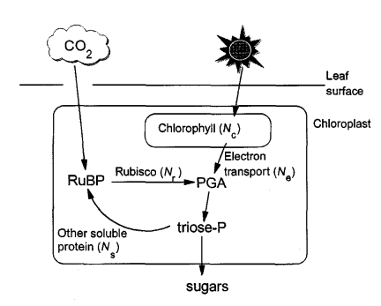
All together now!
Medlyn 1996

Slide 83
Photorespiration

Slide 84
Photorespiration
Rubisco : RibUlose – 1,5 – BISphosphate Carboxylase and Oxygenase
Catalyzes CO₂ and O₂
Catalyzing O₂ leads to “wasteful” respiration (loss of CO₂)
Increases as O₂ increases
Increases with temperature

Slide 85
3 types of photosynthesis systems
C₃: what we already covered
Most plants
C₄: Separate carbon acquisition and sugar creation in space
Typically grasses
CAM: Separate carbon acquisition and sugar creation in time
E.g., Cacti

Slide 86
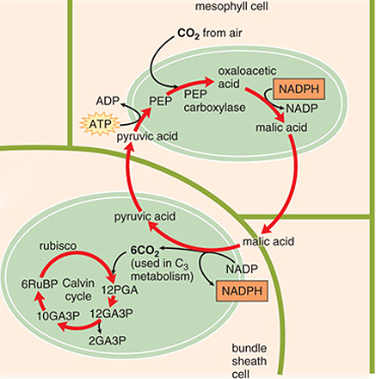
C4 photosynthesis
PEP carboxylase captures CO₂ and creates a 4 carbon sugar in mesophyll
Moves sugar to bundle sheath, where CO2 is removed
Bundle sheath cells surround veins
Calvin cycle progresses as normal
“Costs” two extra ATPs

Slide 87
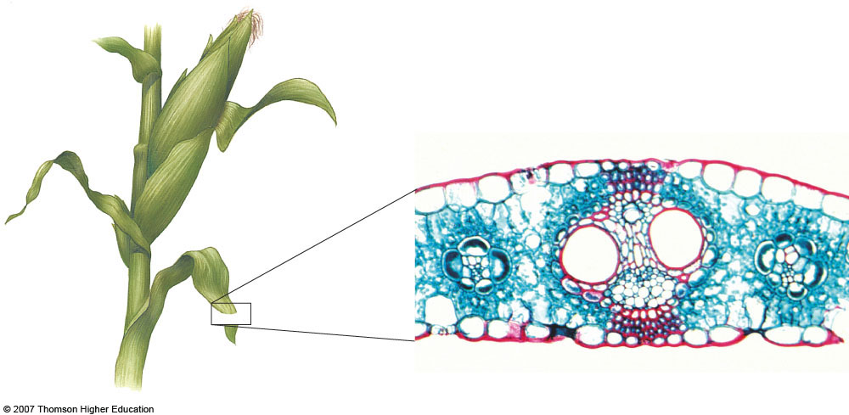
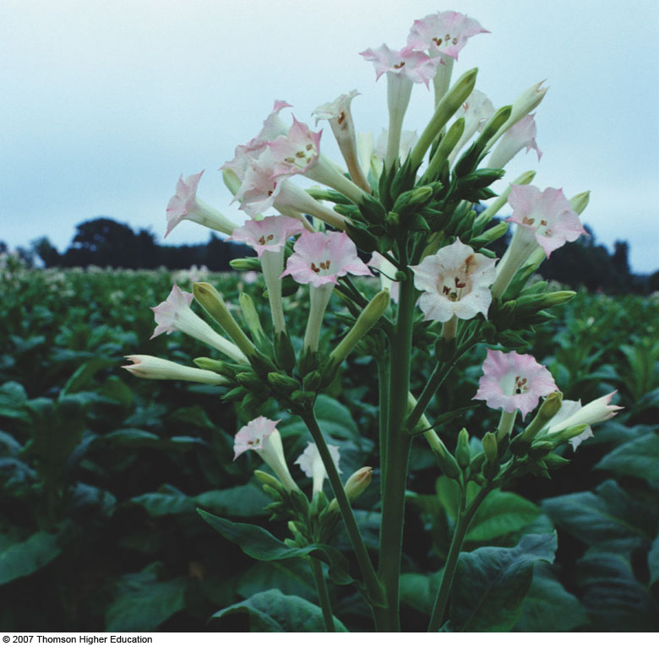
C4 photosynthesis – why the bundle sheath?
Bundle sheath cells
Midvein
Parallel vein
Mesophyll
Upper epidermis
Lower epidermis
Phloem
Xylem

Slide 88
C4 photosynthesis - benefits
PEP carboxylase is not an oxygenase
Good at capturing CO2
Good in low CO2 environments
Good in hot, dry environments
Can close stomata

Slide 89
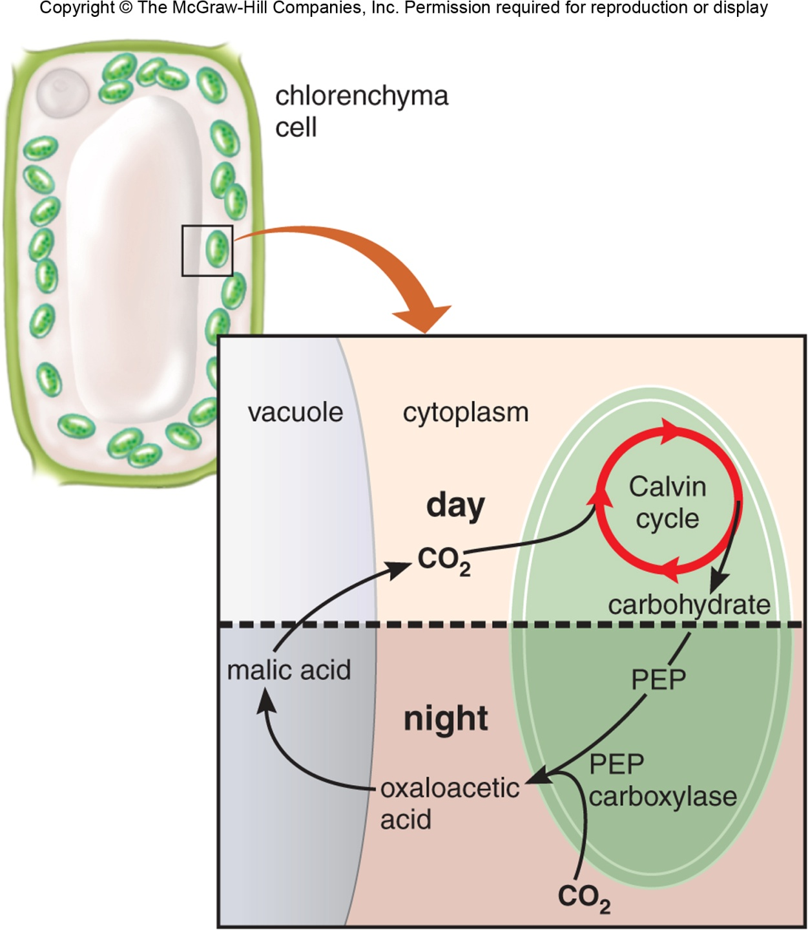
CAM photosynthesis
Opens stomata during the night
PEP carboxylase captures CO₂ and creates a 4 carbon sugar
Closes stomata during the day
Calvin cycle

Slide 90
How is (C3) photosynthesis altered by the environment? Von Caemmerer and Farquhar (1981)

